Slide 1

Diode Transistor Logic
CSE 211 DEPT
Lecturer Uzma Hasan, CSE department

Slide 2
Generation of ics
The number of components fitted into a standard size IC represents its integration scale (Scale of Integration).
Based on the number of components used (typically based on the number of transistors used), they are as follows:
Small-scale integration(SSI) consists of only a few transistors (tens of transistors on a chip), these ICs played a critical role in early aerospace projects.
Medium-scale integration(MSI) consists of some hundreds of transistors on the IC chip developed in the 1960s and achieved better economy and advantages compared to the SSI ICs.
Large-scale integration(LSI) consists of thousands of transistors on the chip with almost the same economy as medium scale integration ICs. The first microprocessor, calculator chips and RAMs of 1Kbit developed in the 1970s had below four thousand transistors.
Very large-scale integration(VLSI) consists of transistors from hundreds to several billions in number (Development period: from 1980s to 2009).
Very very large-scale integration(VVLSI) consists of transistors in excess of more than one million, and later wafer-scale integration (WSI), system on a chip (SoC) and three dimensional integrated circuit (3D-IC) were developed.

Slide 3
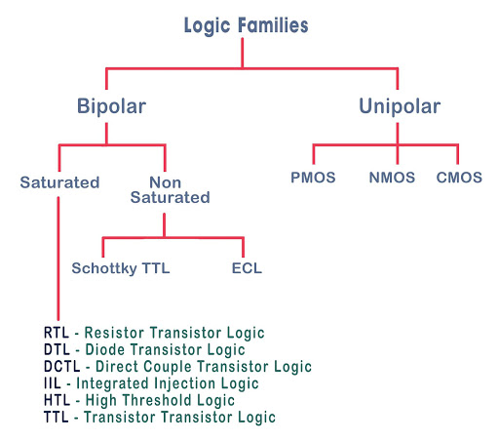
Digital logic families

Slide 4
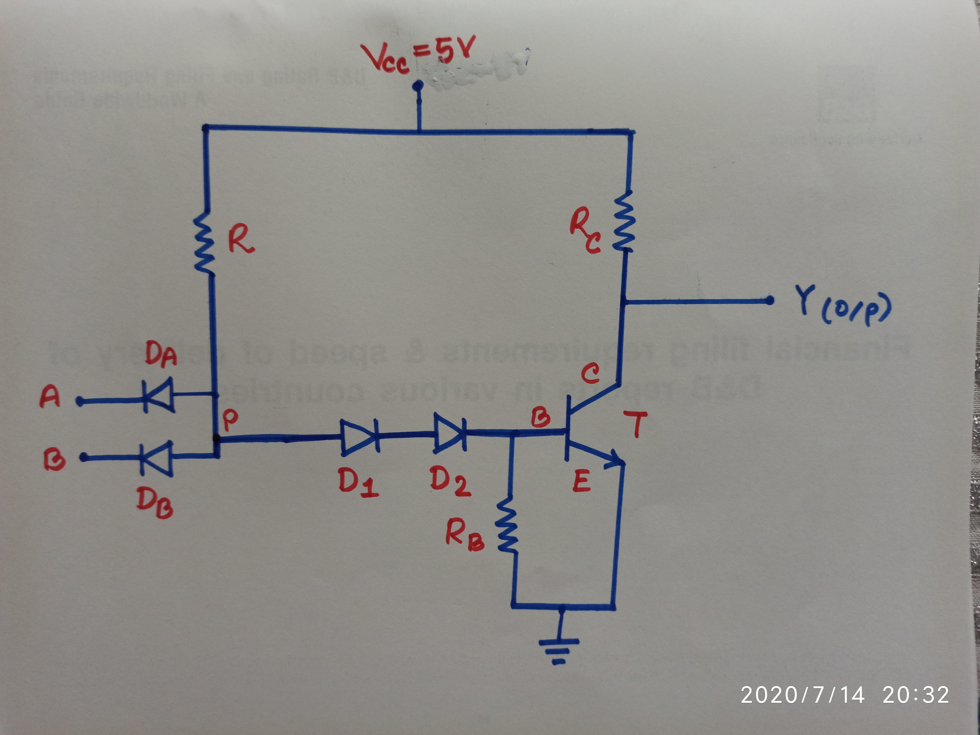
Diode Transistor logic (DTL)
Figure : 2-input DTL NAND gate

Slide 5
Diode Transistor logic (DTL)
A circuit designed with diodes and transistor
By using DTL, we can design a basic NAND gate
In RTL which was invented before DTL, noise immunity and fan out is less, speed low and power dissipation is high
So, to overcome these disadvantages came DTL
In N-input DTL circuit, there will be N no. of diodes in the input
The problems in RTL improved to somewhat in DTL. Here comparatively fan out and noise margin is high but it is a bit slow in operation.
This speed issue of DTL is resolved in TTL later on

Slide 6
DTL operation
CASE 1:
A = 0 and B = 0
Both A and B in FORWARD bias (Short circuit)
So current from Vcc flows directly to A
Thus no sufficient voltage to turn ON D1
Hence D1 is OFF, which causes D2 to be OFF too
As a result, there will not be sufficient voltage at the base B of transistor T (i.e low voltage at the base)
T is therefore in Cut Off region (OFF)
Hence, Open Circuit created
So Y (output) will not be connected to GND
That means Vout or Y connected to Vcc
A | B | Y
0 | 0 | 1
0 | 1 | 1
1 | 0 | 1
1 | 1 | 1

Slide 7
DTL operation
CASE 2 or 3:
A = 0 and B = 1 or Vice versa
Here A is in FORWARD bias (Short circuit) and B is Open ckt (Reverse bias)
So current from Vcc flows directly to A
Thus no sufficient voltage to turn ON D1
Hence D1 is OFF, which causes D2 to be OFF too
As a result, there will not be sufficient voltage at the base B of transistor T
T is therefore in Cut Off region (OFF)
Hence, Open Circuit created
So Y (output) will not be connected to GND
That means Vout or Y connected to Vcc
A | B | Y
0 | 0 | 1
0 | 1 | 1
1 | 0 | 1
1 | 1 | 1

Slide 8
DTL operation
A | B | Y
0 | 0 | 1
0 | 1 | 1
1 | 0 | 1
1 | 1 | 1
CASE 4:
A = 1 and B = 1
Both A and B in REVERSE bias (Open circuit)
So current from Vcc flows directly to D1 (i.e D1 connected to Vcc)
Thus there is sufficient voltage to turn ON D1
Hence D1 is ON, which passes sufficient voltage to the anode of D2 (so D2 is also ON)
As both D1 and D2 are ON, there will be sufficient high voltage at the base B of transistor T
T is therefore in SATURATION region (ON)
Hence, Short Circuit created
So Y (output) will be connected to GND through the short ckt
That means Vout or Y equal to 0 volt

Slide 9
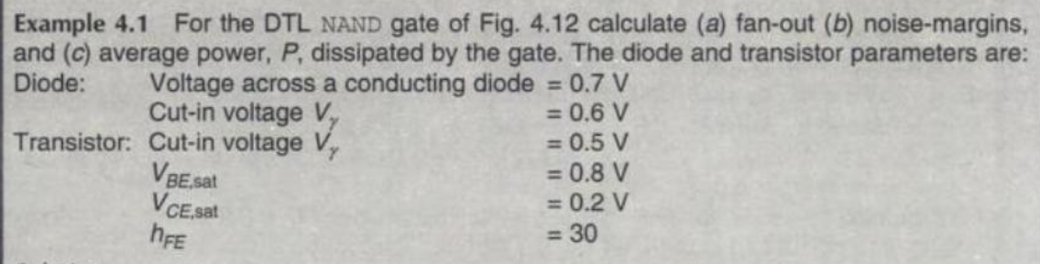
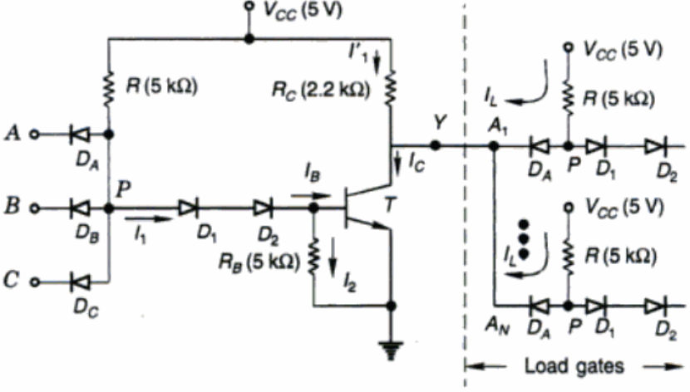

Slide 10
Solution(4.1)
R.P Jain - “Modern Digital Electronics” chapter 4 (Example 4.1)
Class lecture (Pdf solution)
Practice problems
Must Do Exercise Problem Numbers:
4.5 and 4.6 from (“Modern Digital Electronics” chapter 4 by R.P Jain)

Slide 11
references
Book: R.P Jain - “Modern Digital Electronics” chapter 4
For further clarification:
https://www.youtube.com/watch?v=Qsq4HS-P6a4
https://www.youtube.com/watch?v=eUUoBtJAmVI
https://www.youtube.com/watch?v=upYECwnlX0Q

